Slide 1
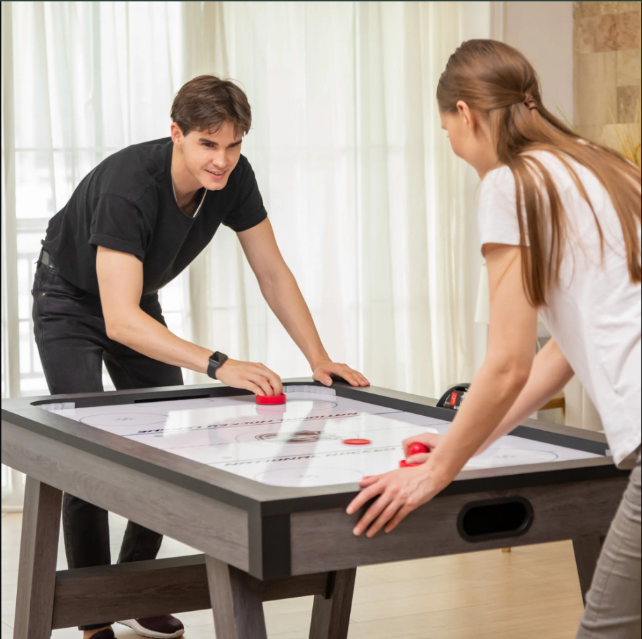

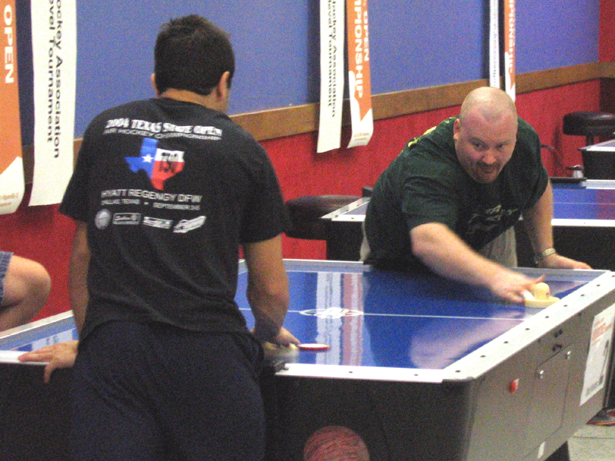
DualPlay
AI Group No 1

Slide 2

Content
Introduction
Problem In Brief
Aim
Objectives
Proposed solution
Resources required
Technologies used
System diagram
Individual Contribution
Budget
Our Team

Slide 3
Introduction
These days, as technology affects every part of our lives, hardware and entertainment combine to create a world of creative possibilities. The main attempt presented by this project is the creation of an independent physical game that Blends traditional gaming with modern technology.

Slide 4
Problem in Brief
No human interaction in traditional computer gaming
Issues on social dynamics and physical health
Traditional physical games require the presence of another player

Slide 5
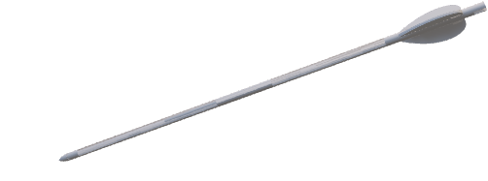
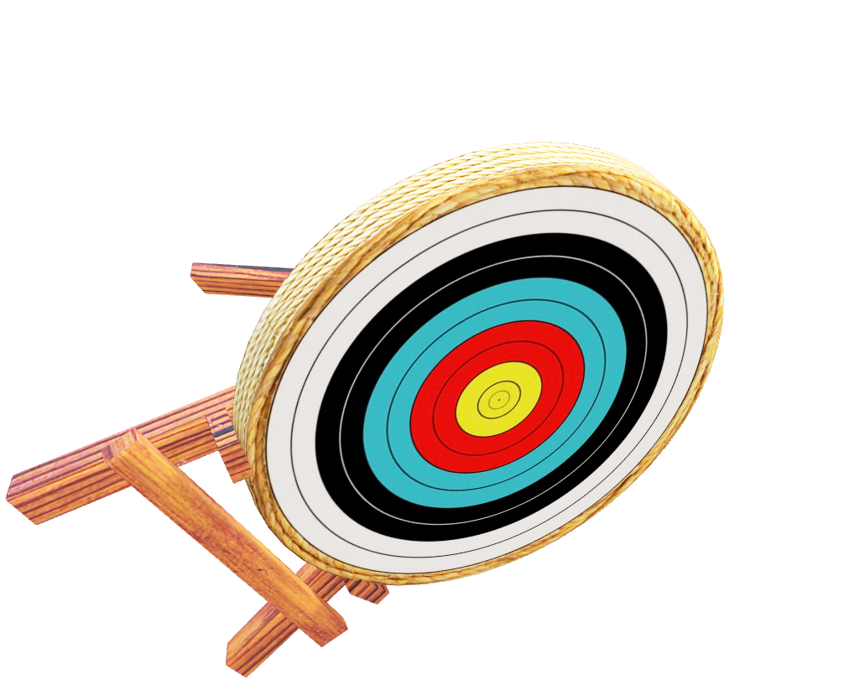
DualPlay

Slide 6
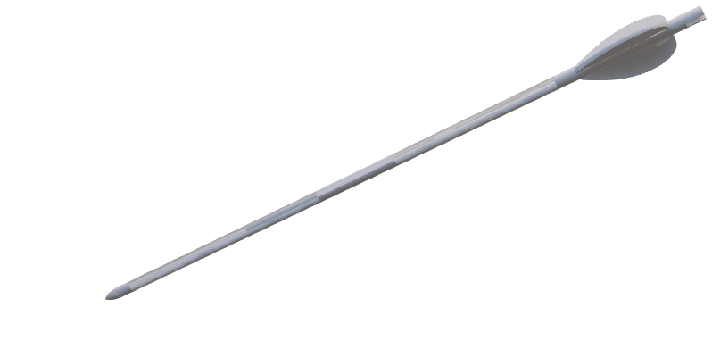

Aim
Create an interactive multiplayer table game that combines the excitement of air hockey with innovative features.

Slide 7
Objectives
Design and build the game with two game modes including an autonomous gameplay mode.
Ensure an enjoyable experience regardless of player availability.

Slide 8
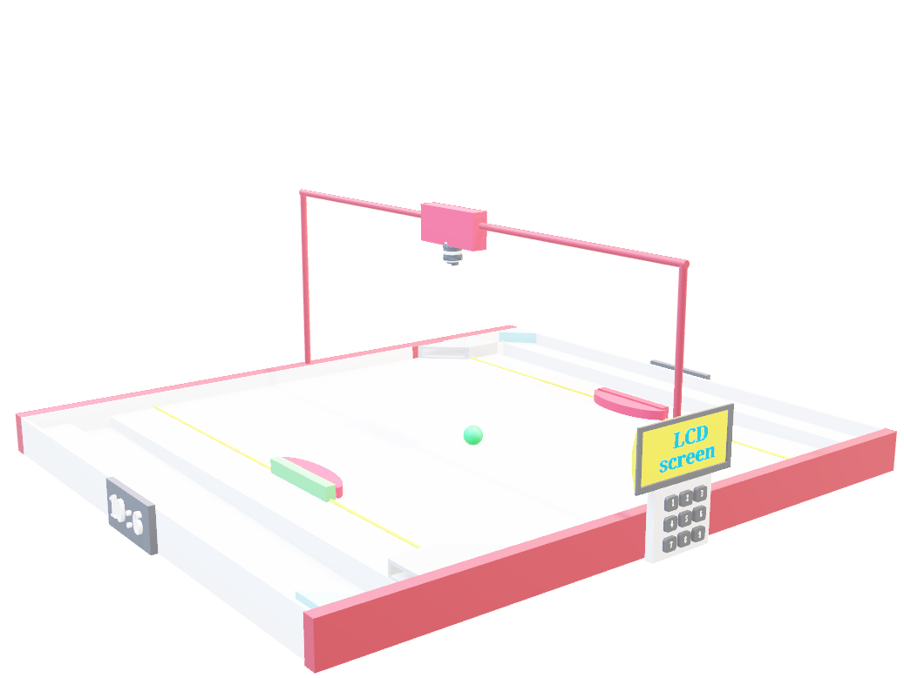
Proposed Solution

Slide 9
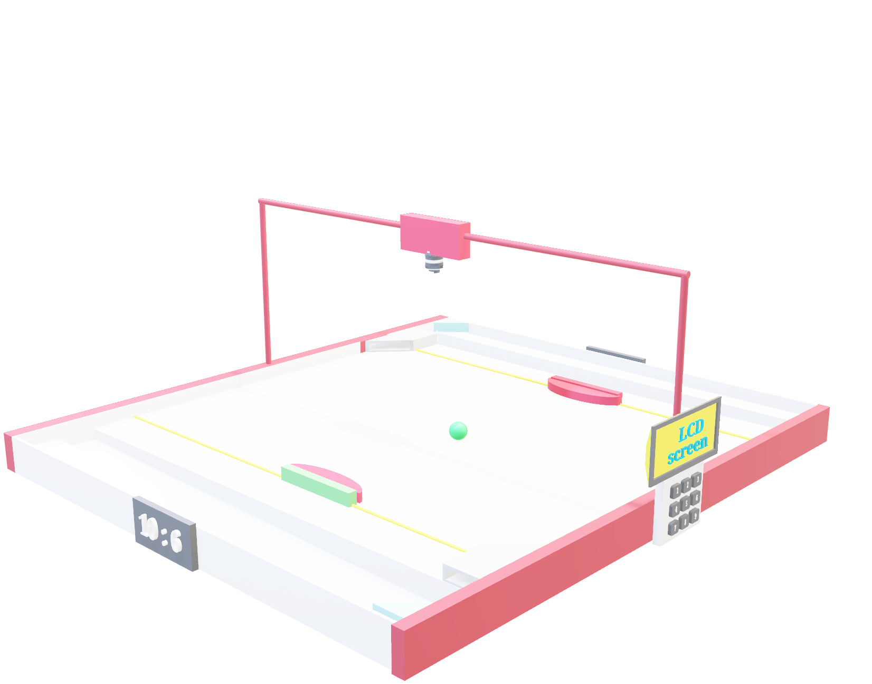
Proposed Solution

Slide 10
Proposed Solution
Camera
Score LCD display
Two paddles
ball
Game setup
LCD and keypad
IR module
Redeploy
Mechanism

Slide 11
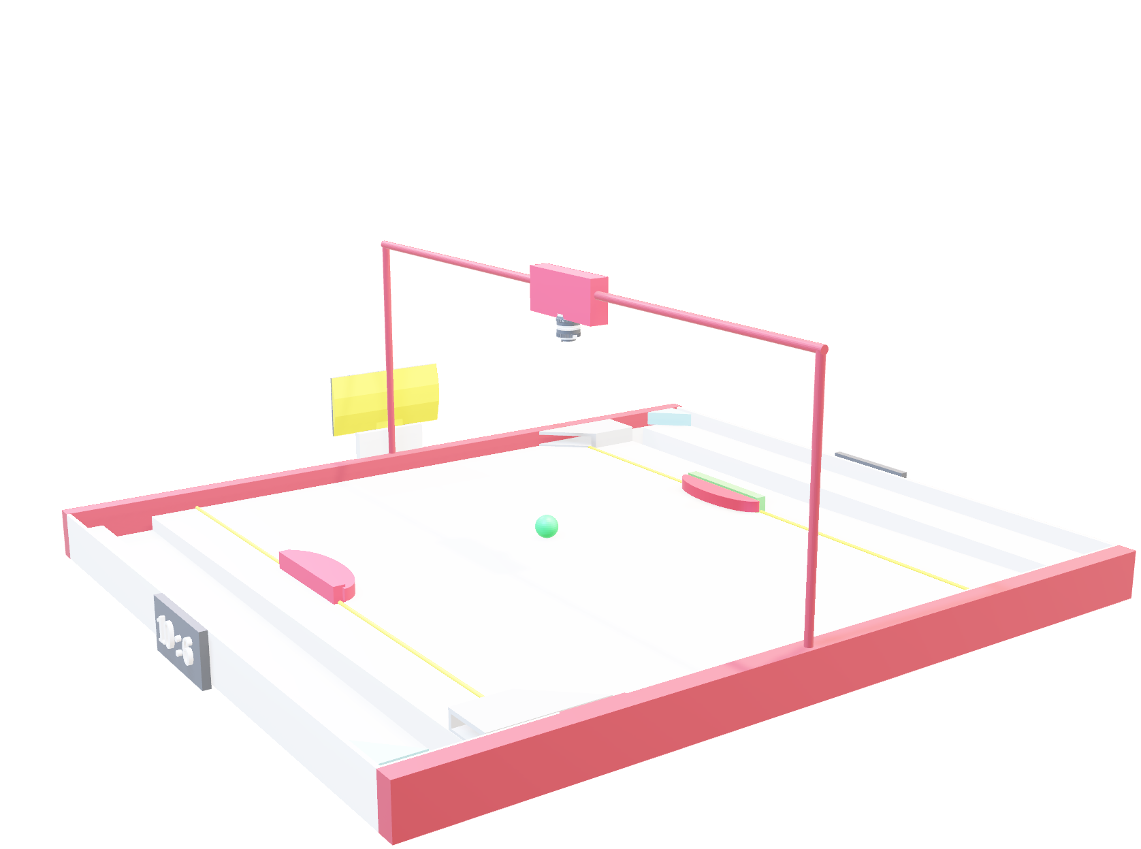
Proposed Solution
Camera
Game setup
LCD and keypad
Score LCD display
Two paddles
ball
IR module
Redeploy
Mechanism

Slide 12
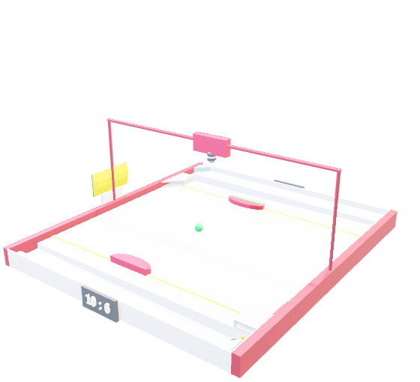
Game Modes - DualPlay
Two game modes
Human vs Human – Two players control paddles using two remotes.
Human vs AI Player – Human player control the paddle using a remote and the paddle of the AI player autonomously controlled according to the ball movement.

Slide 13
Intelligent Features- DualPlay
When the game mode is “Human vs AI”, AI player’s paddle controlled autonomously by tracking the ball and the AI paddle real-time.
When a goal is scored, it will detect autonomously, and scores will be updated according to it.
After a goal is scored, ball will be redeployed back to the play area autonomously without human intervention.

Slide 14
Resources Required - Hardware
Raspberry pi 4 model B
Arduino Mega
Arduino Uno
Nema 17 Stepper motor *2
180-degree SG90 Servo motor *2
360-degree SG90 continuous Servo motor *2
A4988 Stepper Motor Driver *2
12V 30A power supply
Obstacle Avoidance IR module *2
LCD screen with I2C module *3
Keypad
Limit switch *4
Buck converter *3
Solenoid with Relay module

Slide 15

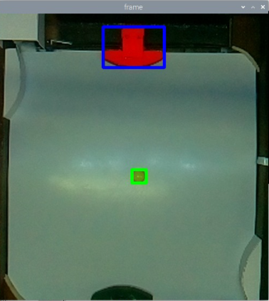



Resources Required
Software
Arduino IDE
Geany editor
Tinkercad
SolidWorks
fritzing

Slide 16
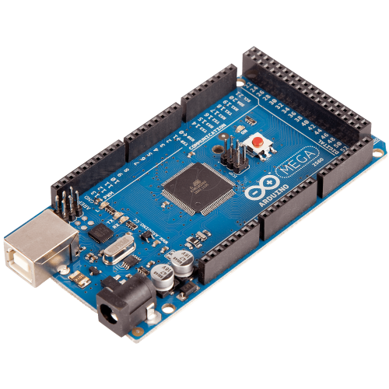
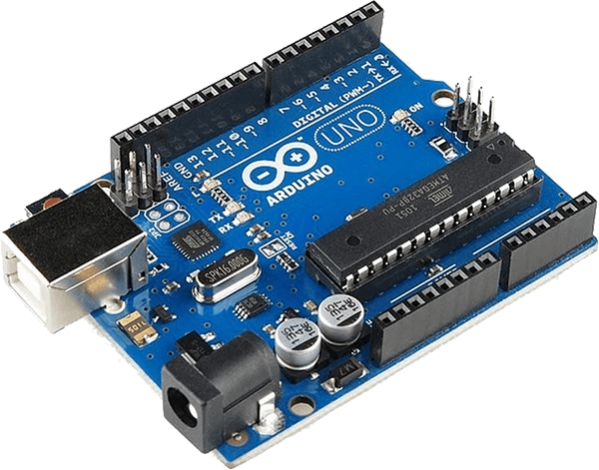
Technologies used
Computer Vision
We implemented a real-time computer vision algorithm using OpenCV in Python to track the colors of the ball and the AI player's paddle. We used HSV color space for this. This allowed us to accurately identify and monitor their positions throughout the game. This computer vision algorithm is executed on Raspberry pi 4 board.

Slide 17
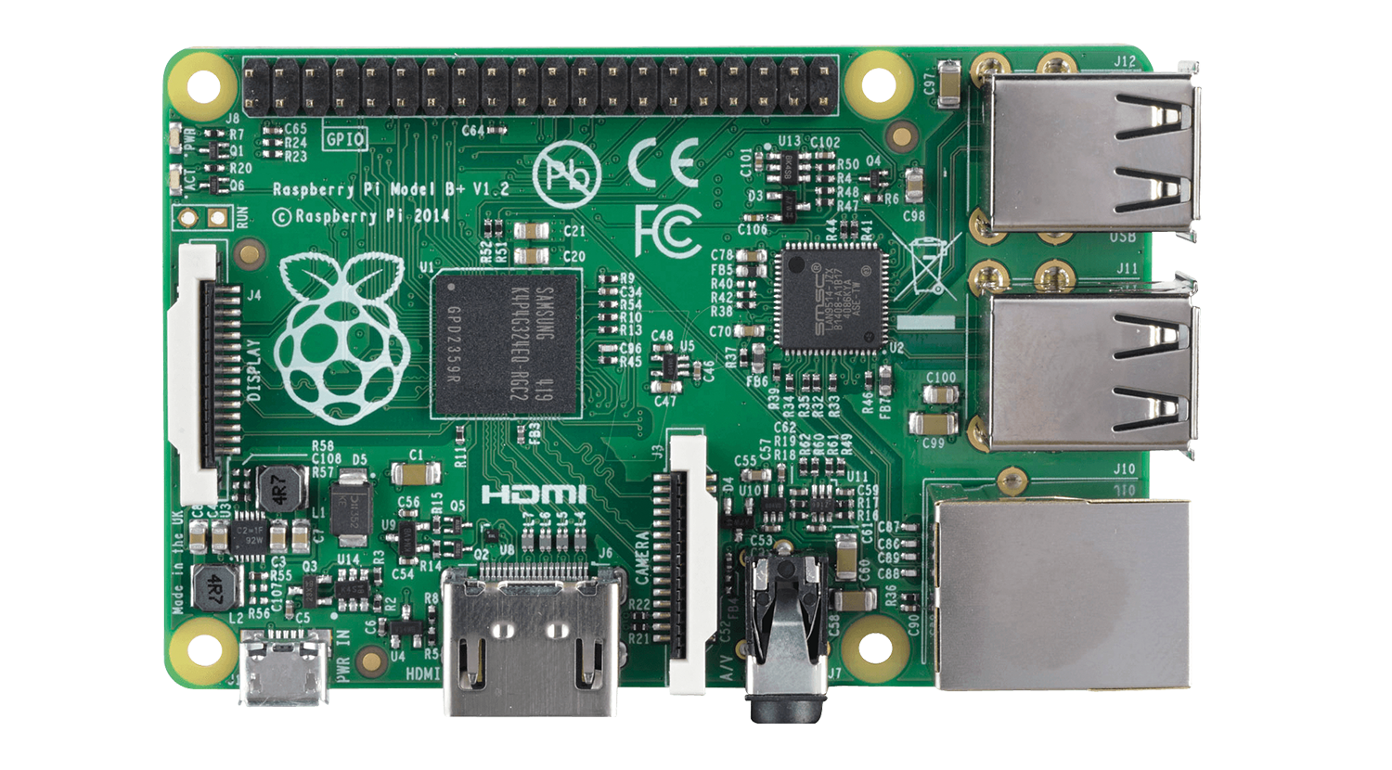
Technologies used
Arduino Mega and Uno
Arduino Mega controls Green Player side (Human player) and Uno controls Red player side (Human/AI). Game setup LCD, Keypad, Score update LCDs, IR modules, Redeploy servo motors are controlled by Mega. Both boards programmed using C++ and Arduino IDE

Slide 18
Technologies used
Serial Communication
We used Serial Communication to communicate between Raspberry pi and two Arduino boards. Arduino boards plugged into raspberry pi through USB ports.

Slide 19
System Diagrams

Slide 20
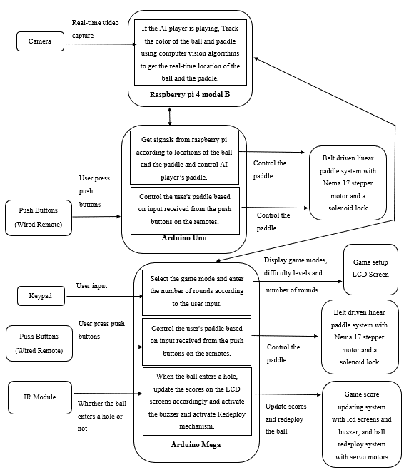
Block Diagram

Slide 21
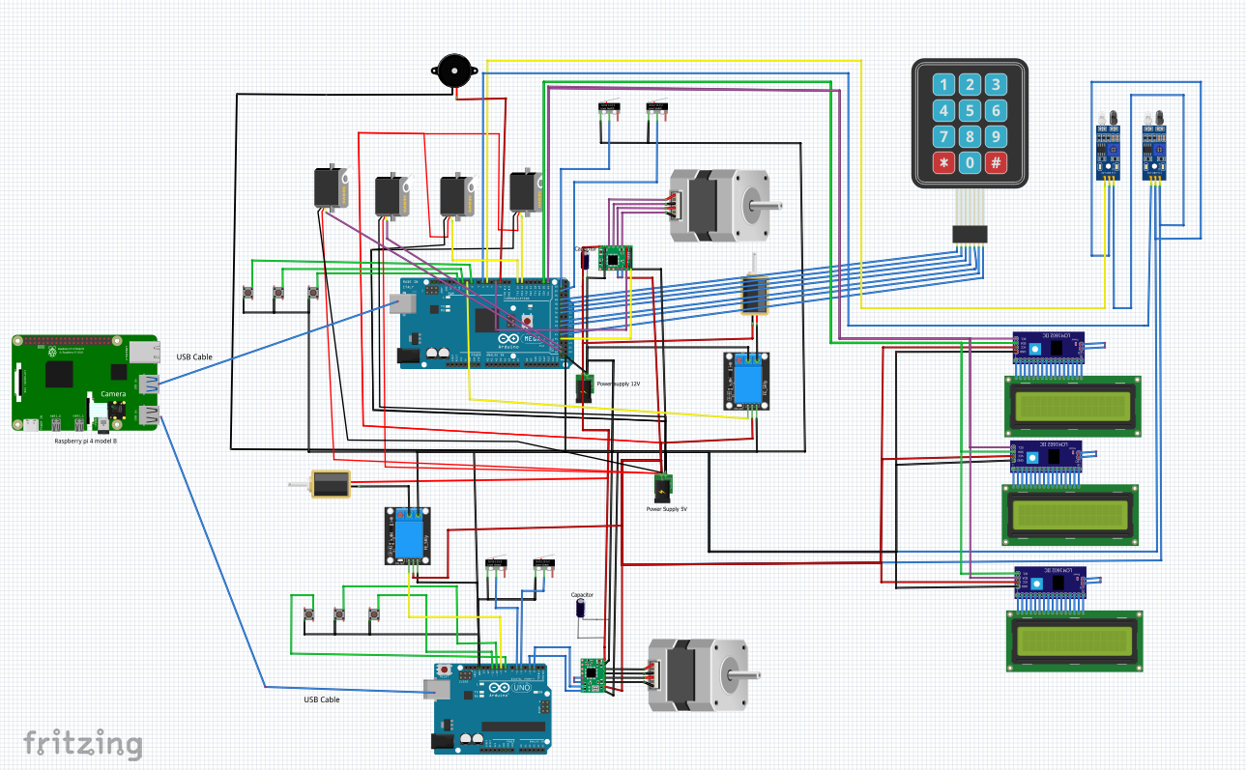
Component Diagram

Slide 22
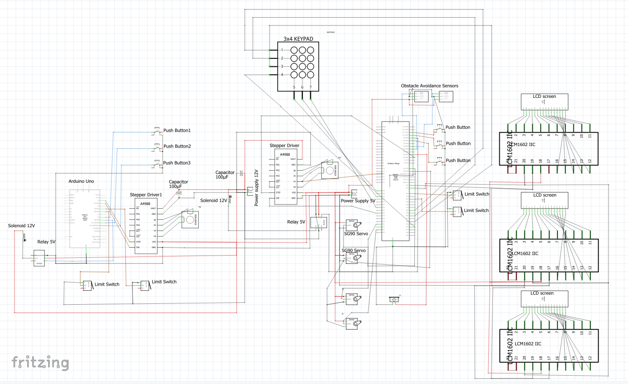
Schematic Diagram

Slide 23
Individual Contribution

Slide 24
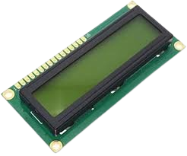
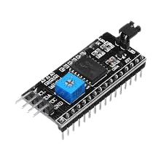
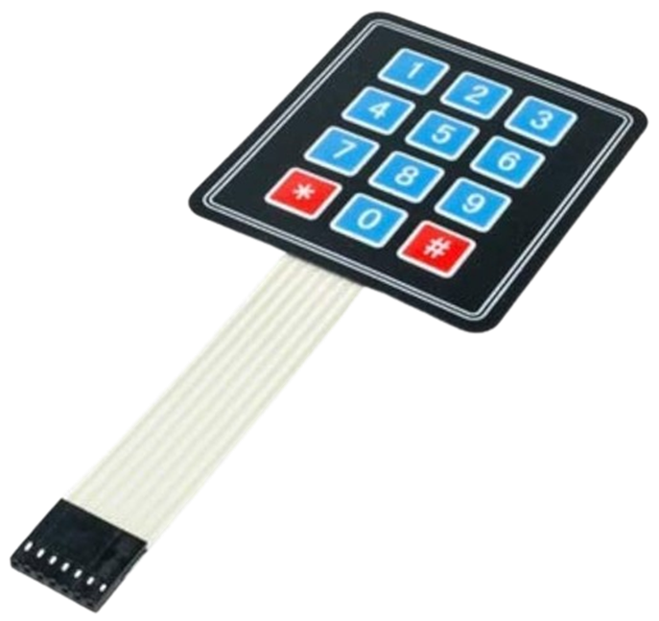
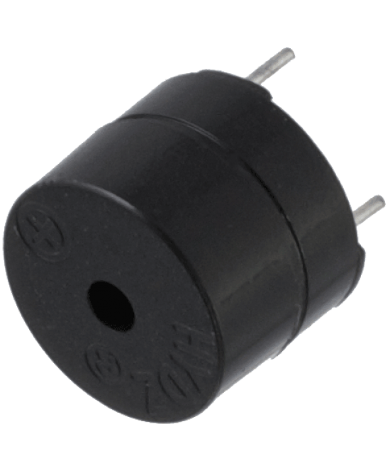
Dhananjana R.A – 225507X
Program 16x2 LCD Screen with I2C Module (0x27 Address) to display Game Setup Functions such as Start/Switch off, Welcome Message, Select Game modes and Enter Number of Rounds.
Program Keypad to get user inputs for Game setup Functions.
Program Active buzzer to sound a Beep when the user is pressing keypad buttons for game setup functions and sound a Beep when a goal is scored.

Slide 25
Dhananjana R.A – 225507X
16x2 LCD Screen is used to display Game setup Functions. It is programmed using a I2C module which is only uses SDA pin and SCL pin of Arduino Mega. This Game setup LCD with I2C module uses 0x27 Address.
This LCD with I2C module is programmed using LiquidCrystal I2C Library in Arduino IDE.

Slide 26

Dhananjana R.A – 225507X
4x3 12-Key Keypad module is used to get user inputs for game setup Functions.
This keypad is programmed using Keypad.h Library in Arduino IDE.
Keypad lets the user to select start/switch off, the game mode and Enter the number of Rounds user needs to play.

Slide 27
Dhananjana R.A – 225507X
An active buzzer produces a continuous beep sound when a DC pulse is applied to it.
It is used to sound a Beep when user is pressing keypad buttons for Game Setup Functions and when a goal is scored.

Slide 28
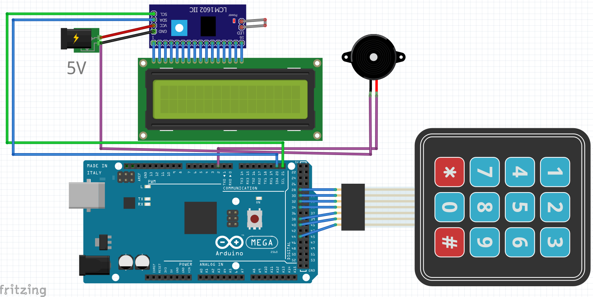
Dhananjana R.A – 225507X

Slide 29
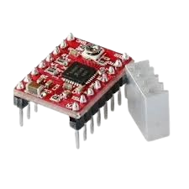
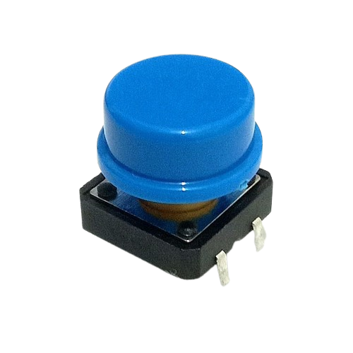
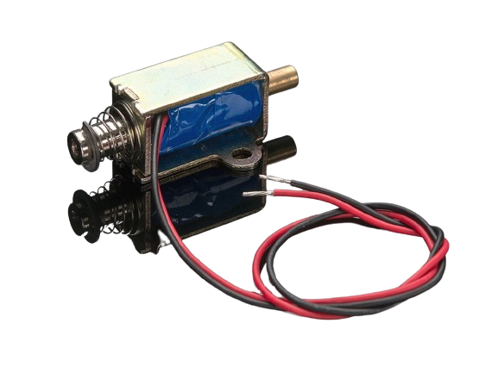
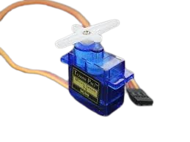
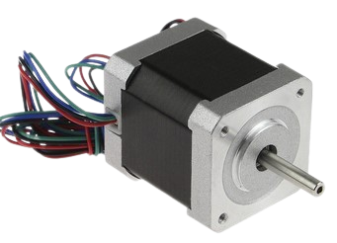
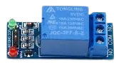
Epasinghe S.K - 225511E (Leader)
Program Nema 17 stepper motor with A4988 stepper driver to control the paddle movement of Human player according to push button inputs.
Program relay module with Solenoid push-and-pull module to strike the ball according to the push button input for Human player.
Program 360 continuous Servo motor to lift the ball after a goal is scored.

Slide 30
Epasinghe S.K - 225511E (Leader)
Nema 17 Stepper motor is used to Control the movement of the Paddle(belt driven Linear Actuator) of the Human player According to two Push button Inputs. (Left and Right)
Nema 17 is controlled by using A4988 Stepper Motor Driver which only uses two Arduino Mega digital Pins.

Slide 31
Epasinghe S.K - 225511E (Leader)
Solenoid Push and Pull module is used to strike to the ball According to a push button input from the Human Player. It is controlled by using a low-level trigger 5V Relay Module.

Slide 32
Epasinghe S.K - 225511E (Leader)
This 360 continuous Servo motor can rotate continuously without just rotating a maximum of 180 degree.
After a goal is scored, 360 continuous Servo motor will lift the ball back to the level of the play area using the rack and pinion mechanism. This Servo is programmed using Servo.h library.

Slide 33
Epasinghe S.K - 225511E (Leader)
After the ball is pushed to the playground the servo will lower the stand back to the pit level, ready to catch the ball again.

Slide 34
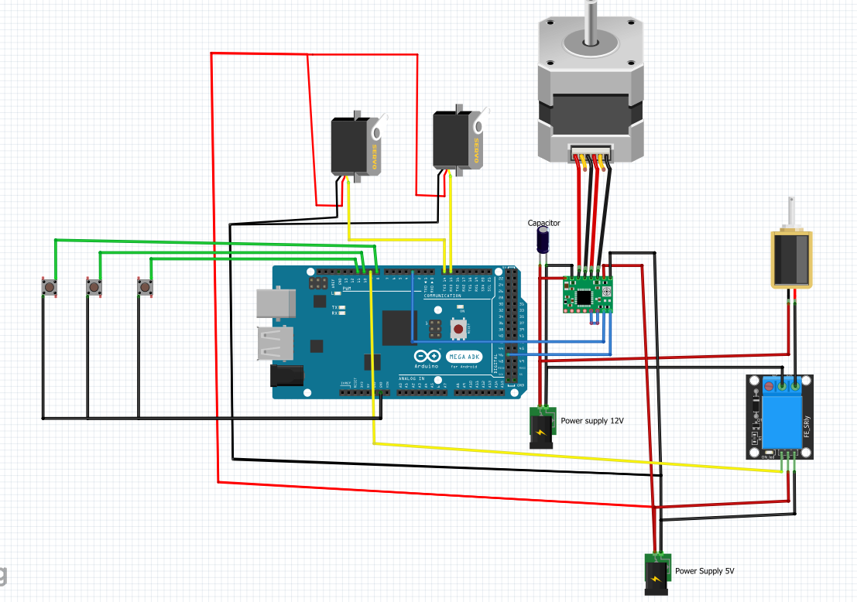
Epasinghe S.K - 225511E (Leader)

Slide 35
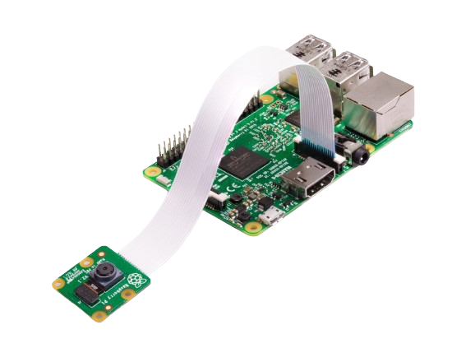
Helapalla K.O.R.I – 225520F
Program the camera to identify the color of the ball and the color of the paddle of AI player and get their real-time locations. (x , y coordinates)
Program Nema 17 stepper motor with A4988 stepper motor driver to control the paddle of AI player and program the solenoid push and pull module with relay module to strike the ball (AI player) according to the locations of the ball and the paddle.
Use Serial Communication to Identify and distinguish the correct ports of Arduino Mega and Uno that are connected to the raspberry pi using two USB ports. Assemble the final codes with Serial Communication.

Slide 36
Helapalla K.O.R.I – 225520F
Raspberry pi Camera module is used to get the real-time frames of the play-area.
Implemented a computer vision algorithm to track the color using HSV color space to get the real-time locations of the ball and the AI player’s paddle. OpenCV library in python is used for this.

Slide 37
Helapalla K.O.R.I – 225520F
With the help of real-time locations of the ball and the AI player’s paddle, Raspberry pi sends characters to Arduino Uno using Serial Communication to control the movement of AI player’s paddle and to control the Solenoid push and pull module with relay module to strike the ball from AI player side.

Slide 38
Helapalla K.O.R.I – 225520F
Nema 17 with A4988 stepper motor driver controls the AI player’s paddle movement (Belt driven linear actuator) according to those signals came from Raspberry pi.
‘-1’ – Ball and the AI player’s paddle is aligned , So Do Nothing
‘0’ – Move the paddle to the Right side
‘1’ – Move the paddle to the Left side

Slide 39
Helapalla K.O.R.I – 225520F
Solenoid Push and Pull module is used to strike to the ball According to the signal came from Raspberry pi using Serial Communication. It is controlled by using a low-level trigger 5V Relay Module. If the character came from Raspberry pi is ‘2’, it means ball is close to the AI player’s paddle.

Slide 40
Helapalla K.O.R.I – 225520F
At the beginning of the code, identified and distinguished the correct ports of Arduino Mega and Uno, which are connected to the Raspberry Pi using USB ports. Defined functions such as sendUno, getUno, sendMega, and getMega in the python code for ease after identifying the correct ports. Assemble the final codes with Serial Communication. (baud rate – 115200)
Two ports -
'/dev/ttyACM0’ , '/dev/ttyACM1'

Slide 41
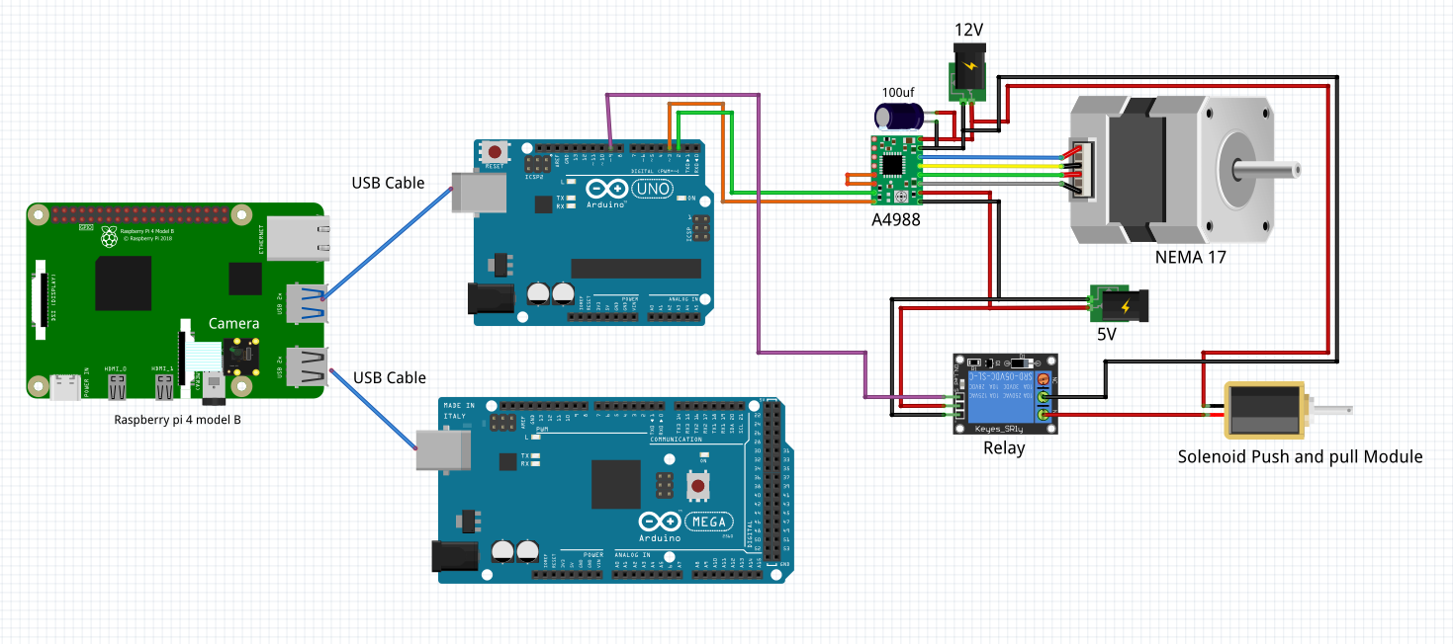
Helapalla K.O.R.I – 225520F

Slide 42
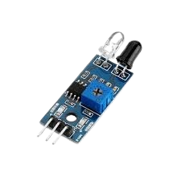
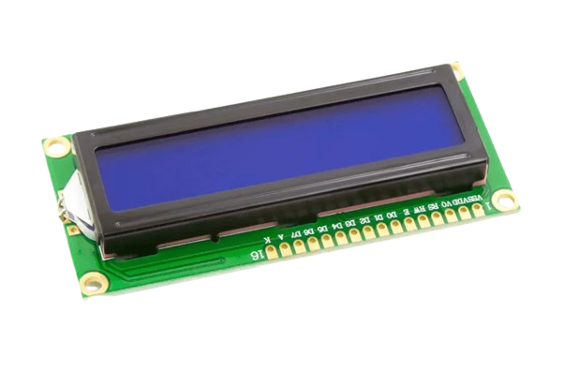
Randinu L.L – 225537M
Program Obstacle avoidance IR module in both sides to detect whether a goal is scored.
Program two 16x2 LCD Screens with I2C modules in Both sides to Display Score Updates and to Display the winner after a Match is Finished.

Slide 43
Randinu L.L – 225537M
Obstacle avoidance IR module is used in each side to detect if a Goal is scored by a player.
After a goal is detected, two score update LCD screens are updated with the current scores of two players.
After a Match is Finished, a Winning text is shown in Winner’s side LCD screen.

Slide 44
Randinu L.L – 225537M
Two 16x2 LCD Screens with I2C modules are used to display game scores. They only use SDA pin and SCL pin of Arduino Mega. Red player side LCD screen with I2C has 0x26 address and Green player side has 0x25 address.
These LCDs with I2C modules are programmed using LiquidCrystal I2C Library in Arduino IDE.

Slide 45
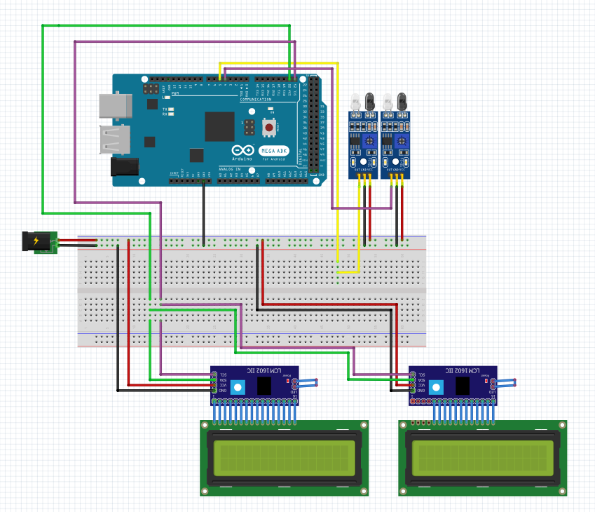
Randinu L.L – 225537M

Slide 46
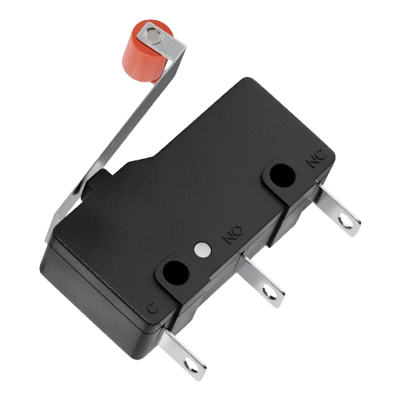
Nimraka T.M.N – 225529P
Program relay module with Solenoid push-and-pull module to strike the ball according to the push button input for Human player.
Program 180-degree Servo motor to push the ball back to the play area after a goal is scored.
Program four limit switches to identify the end points of two Paddles. (Belt driven Linear actuators)

Slide 47
Nimraka T.M.N – 225529P
Solenoid Push and Pull module is used to strike to the ball According to a push button input from the Human Player. It is controlled by using a low-level trigger 5V Relay Module.

Slide 48
Nimraka T.M.N – 225529P
After a goal is scored 360-degree servo motor will lift the ball to the play-area.
After that 180-degree servo motor will strike the ball back to the play area. This Servo is programmed using Servo.h Library.

Slide 49
Nimraka T.M.N – 225529P
Four Limit switches are used to identify the end points of two paddles. (Belt driven linear actuators)
Limit switches are in normally open mode and when a limit switch is closed it means the paddle is now in an end point and Paddle can’t move furthermore to that side.

Slide 50
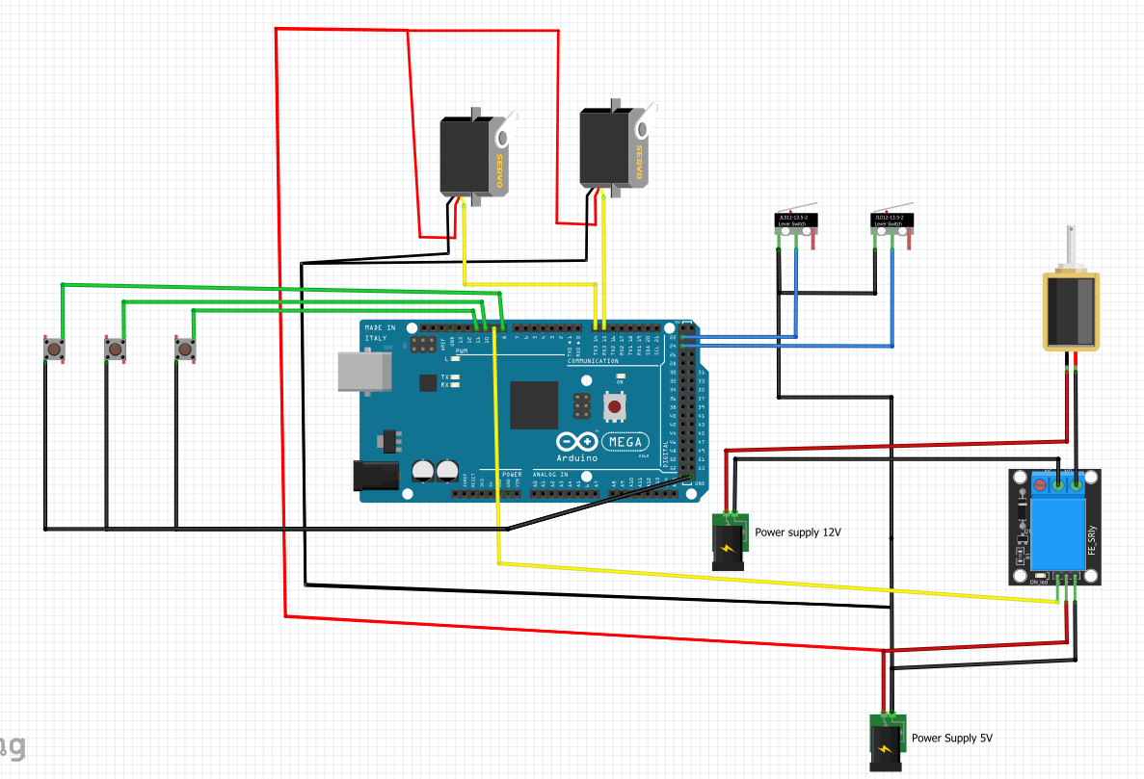
Nimraka T.M.N – 225529P

Slide 51
Budget
Item name | Price
Raspberry Pi 4 Model B 2GB RAM | 21650
Arduino Mega | 4500
Arduino Uno | 2900
Kingston MicroSD 32GB | 1850
5V 3A Micro USB Power Adapter (Raspberry Pi) | 1050
Tactile Push Button 12x12x7.3mm * 6 | 120
Servo Motor SG90 180 * 2 | 760
Servo Motor SG90 360 * 2 | 760
3x4 Numeric Matrix Array Keypad * 1 | 200
1602 16x2 Blue Backlight LCD Display * 2 | 760
1602 16x2 Green Backlight LCD Display | 380
IIC/I2C/TWI/SPI Serial Interface Board Module Port for 1602 LCD Display PCF8574T * 3 | 660
Item name | Price
Camera Module v1.3 5MP 1080p 720p for Raspberry Pi 3 | 1350
15-Pin Ribbon Cable 100cm Flex CSI Raspberry Pi Camera * 2 | 340
17HS8401 NEMA 17 Stepper with wire 0.52Nm (D Shaft 5mm) * 2 | 5000
1Kg 3D Printer Filament | 5400
30 Teeth Timing Pulley (5mm Bore) * 2 | 1120
Brown GT2 6mm Timing Belt (Anti-Slip) 1m | 350
Cladding board (57cm * 58.5cm) | 1500
Solenoid switch JF-0826B Pull-Push-Type * 2 | 2400
2020 t slot aluminum extrusion 1m | 2350
NEMA 17 stepper mounting plate bracket * 2 | 460
Micro Limit Switch * 4 | 120

Slide 52
Budget
Item name | Price (LKR)
A4988 Stepper motor driver * 2 | 560
GT2 6mm Timing Belt Transitioner for 2020 Aluminium Profile * 2 | 4100
XL4015 8-36VDC to 1.25-32VDC 5A DC to DC Step-Down Buck Adjustable Power Supply Module* 2 | 600
5VDC 1 Way 1 Channel Relay Module * 2 | 460
12V 30A SMPS Power Supply Metal Casing | 3100
Obstacle Avoidance Sensor IR Module * 2 | 240
PAM8403 3W stereo AMP | 80
4 Ohm 3W Speaker | 400
Active Buzzer 5V | 50
Total | 65630

Slide 53



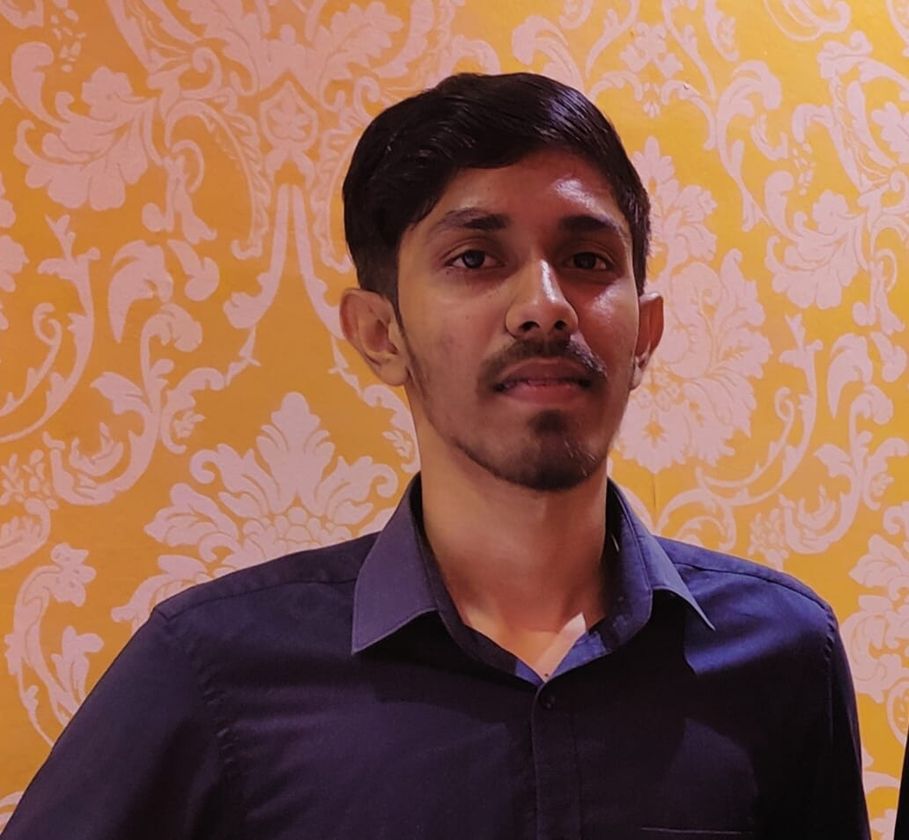
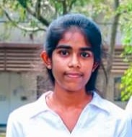
Our Team
Helapalla K O R I 225520F
Dhananjana R A
225507X
Nimraka T M N
225529P
Epasinghe S K 225511E
(Leader)
Randinu L L
225537M
AI Group No. 01

Slide 54
Our Team
Epasinghe S K 225511E
(Leader)
Helapalla K O R I 225520F
Dhananjana R A
225507X
Nimraka T M N
225529P
Randinu L L
225537M
AI Group No. 01

Slide 55
Our Team
Epasinghe S K 225511E
(Leader)
Helapalla K O R I 225520F
Dhananjana R A
225507X
Nimraka T M N
225529P
Randinu L L
225537M
AI Group No. 01

Slide 56
Our Team
Epasinghe S K 225511E
(Leader)
Helapalla K O R I 225520F
Dhananjana R A
225507X
Nimraka T M N
225529P
Randinu L L
225537M
AI Group No. 01

Slide 57
Our Team
Epasinghe S K 225511E
(Leader)
Helapalla K O R I 225520F
Dhananjana R A
225507X
Randinu L L
225537M
Nimraka T M N
225529P
AI Group No. 01

Slide 58
References
"merriam-webster," 2 2 2024 : https://www.merriam-webster.com/dictionary/air%20hockey.
"open builds part store," 10 1 2024 : https://openbuildspartstore.com/v-slot-nema-17-linear-actuator-bundle-belt-driven/.
A. TEAM, "arduino.cc," : https://blog.arduino.cc/2018/10/29/linear-movement-with-arduino-and-3d-printing
Felipe, "Computer vision engineer," : https://www.youtube.com/watch?v=eDIj5LuIL4A .
"Mechanical Design Masters," : https://youtu.be/ve9M8d6KfdI?si=8PxCvQbe-xPVnI0p.
"OpenCV," : https://docs.opencv.org/3.4/df/d9d/tutorial_py_colorspaces.html.
"OpenCV," : https://docs.opencv.org/3.4/da/d97/tutorial_threshold_inRange.html.
"OpenCV," : https://docs.opencv.org/4.x/d3/d05/tutorial_py_table_of_contents_contours.html.

Slide 59
Thank You

